Slide 1

BUILDING A CUSTOMIZED WEB CRAWLER
By Batch D8:
Uddharsh Vasili (17N31A05N4)
Mukul Mokkapati (16N31A05B3)
S. Shiva Teja Reddy (17N31A05L6)
Guided By:
Mr. Nusrath Khan

Slide 2
ABSTRACT
A web crawler is a computer program or an automated script that automatically searches documents on the Web in a methodical manner. Crawlers are primarily programmed for recursive actions so that browsing is automated.
Few of the existing crawlers are Google’s Googlebot, Microsoft’s Bing bot, etc. These crawlers serve a major purpose in indexing a vast amount of data available throughout the internet and enabling search engine optimization.
This project runs on a user driven web crawler where user input will direct what the crawler should navigate upon. In this project, a driver code implemented in python using the beautiful soup module, will extract all the data available in the specified webpage, after which the obtained data has to be collected and stored in a proper format and finally display the required information to the user in an efficient manner.
The aim of the project is to deliver all the relevant data with respect to the search string, from an entire college’s website, where the user need not traverse through the entire website to retrieve a certain piece of information, instead the user can directly enter the keyword with which the crawler will fetch the required information, in a swift and efficient manner.

Slide 3
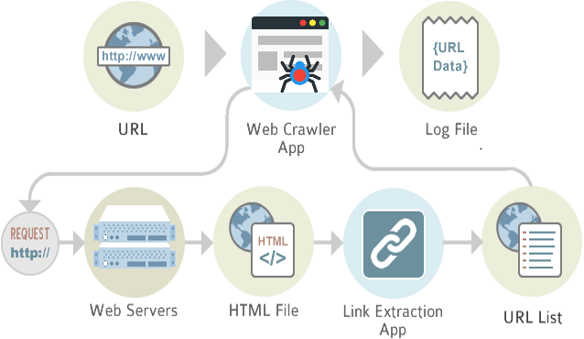
INTRODUCTION
The internet contains enormous amount of data. The data needs to be properly indexed for easy, quick retrieval.
Since it is difficult for indexing such vast amount of data manually, we automate the indexing process using a crawler, which is an automated script that is operated by the search engine in order to crawl through the available data and return the information required.
This project involves the development of a focused web crawler, which takes a set of URLs and keywords as the input, then it executes these instructions automatically which allow it to navigate through the hyperlinks in the sitemap specified in a methodical manner, until the required information is retrieved. After which an index of results generated can be accessed through an output software.

Slide 4
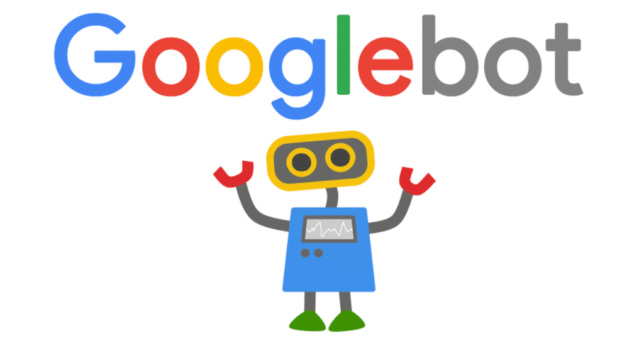

EXISTING SYSTEM
Since the last decade, the extraction of data from the internet has become very swift and efficient with the advent of web crawlers.
There are many open source web crawlers available online. But it must be observed that these web crawlers are designed to serve generic retrieval purposes or to serve along specific processes to acquire the desired result.
Few existing web crawlers in the market are Google’s Googlebot, Bing’s bingbot, Yahoo’s slurpbot, Duckduckgo’s duckduckbot, etc.

Slide 5

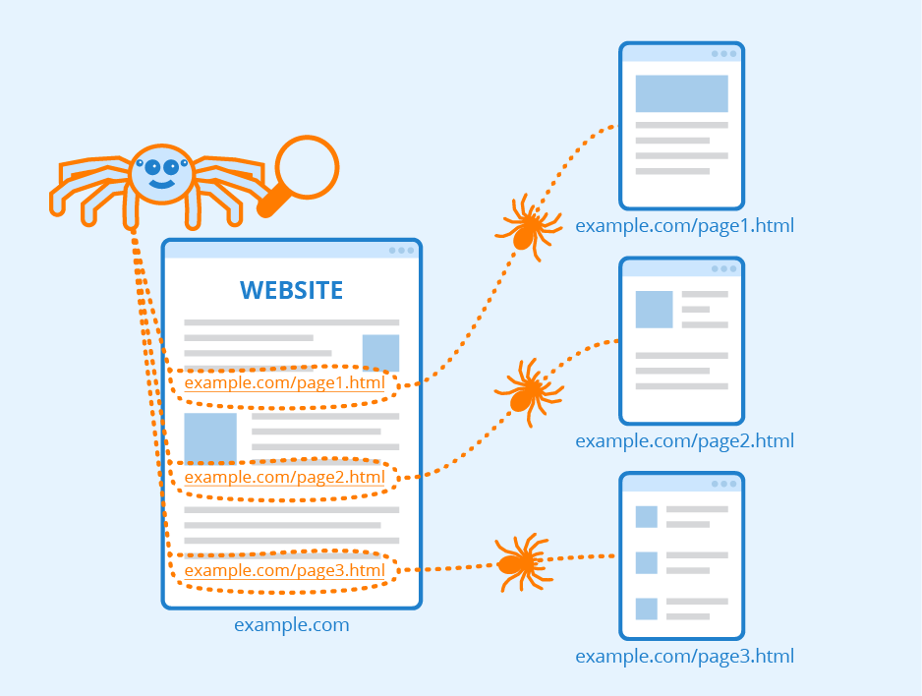
PROPOSED SYSTEM
Though there are many open source web crawlers available online, many of them are designed to serve general purposes or perform specific tasks to retrieve the required information.
This project is specifically tailored to extract required documents and information from our college website.
This project involves the use of various algorithms and data structures, to retrieve the information required in an efficient manner.

Slide 6
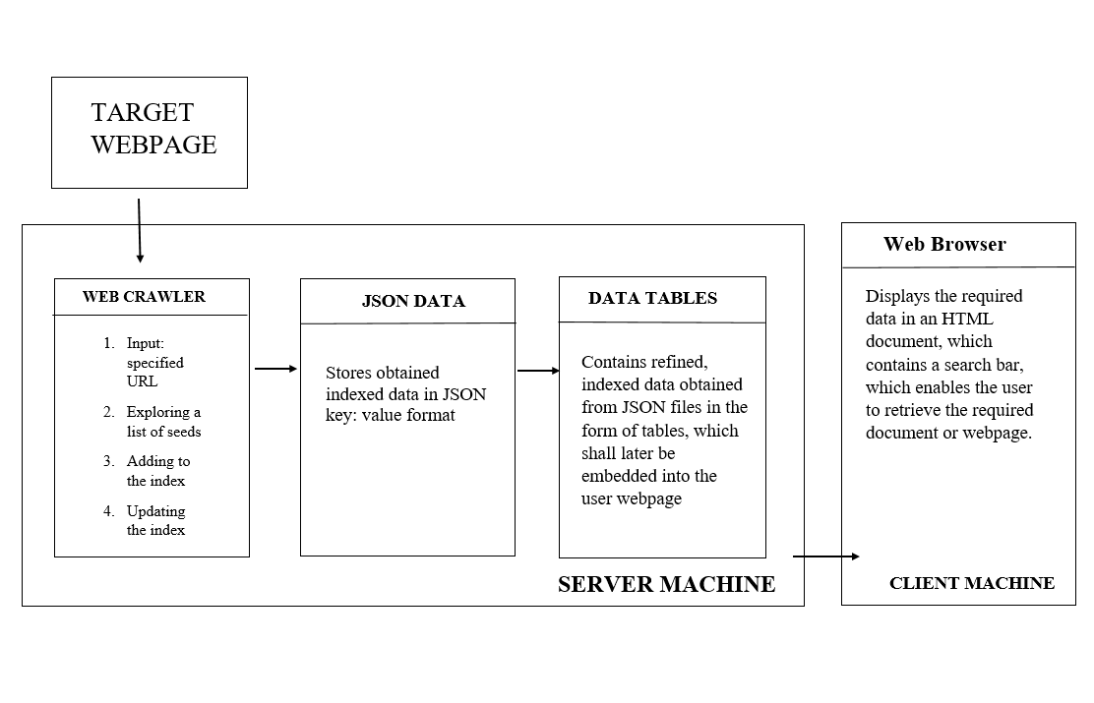
WORKING MODEL OF THE PROJECT

Slide 7
SYSTEM REQUIREMENTS
HARDWARE AND SOFTWARE REQUIREMENTS:
Recommended Software Requirements
Python (Version 3).
Browser: preferably Chrome (v85.0.4183.102 (Official Build) (64-bit)) and Firefox (v80.0.1 (64-bit)).
Internet Connection: at least 30 mbps of upload and download speed.
Operating System: Windows 10.
Minimum Hardware Requirements
Ram: 1GB Ram and above.
Hard Disk Space: 50 GB and above (Windows 10 requires a min of 32 GB of hard disk space).
Processor: Dual core and above.
Note: Better hardware specs enable higher performance and quicker crawling and retrieval of results.

Slide 8
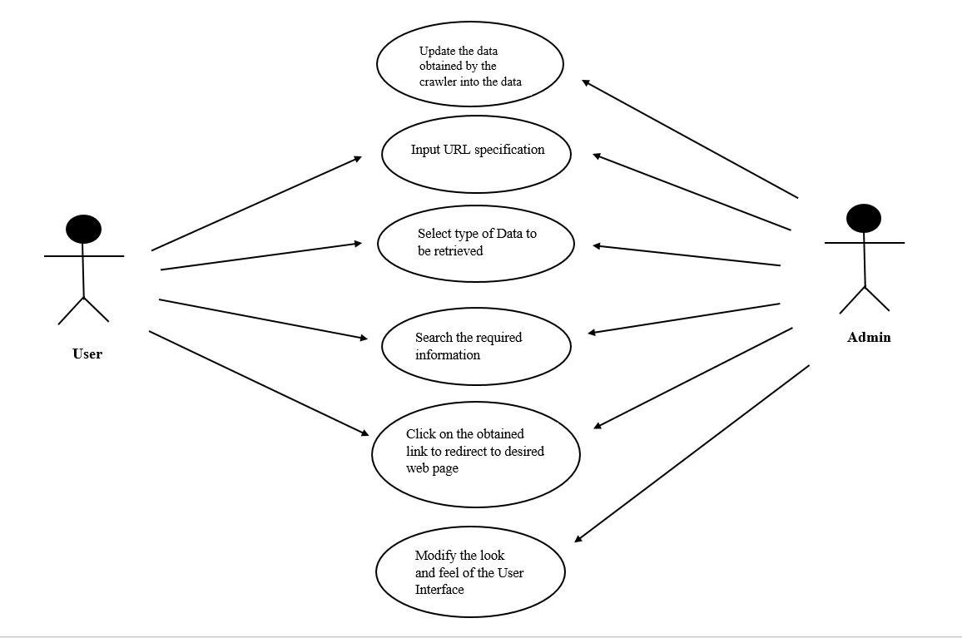
UML DIAGRAMS
USE CASE DIAGRAM

Slide 9
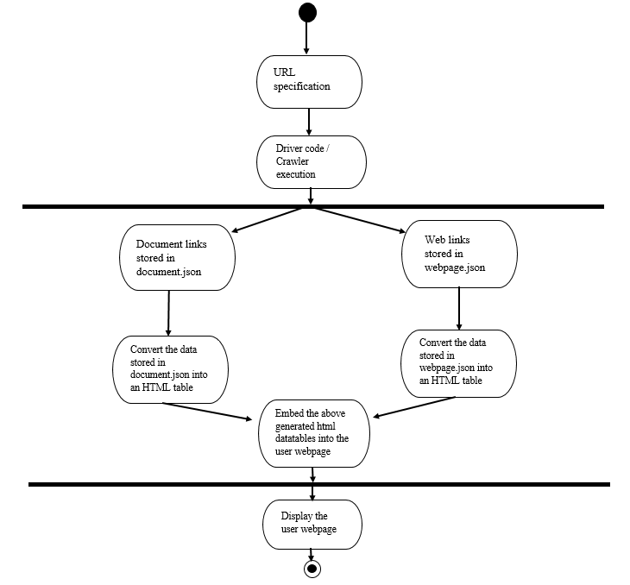
UML DIAGRAMS (continued….)
ACTIVITY DIAGRAM

Slide 10
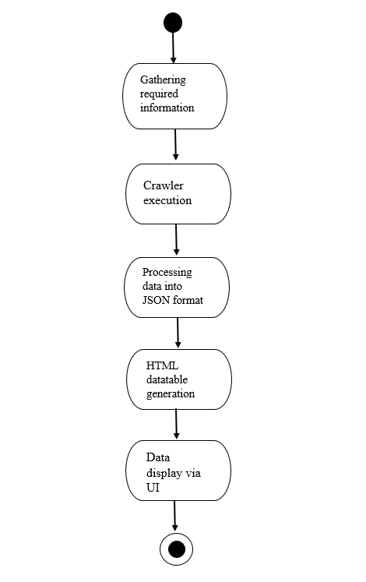
UML DIAGRAMS (continued….)
STATE CHART DIAGRAM

Slide 11
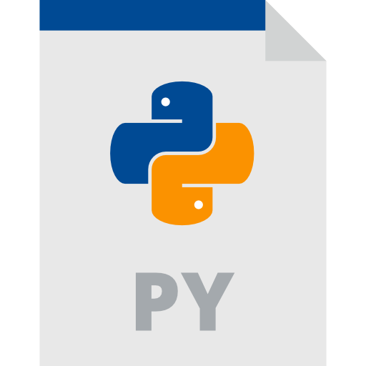
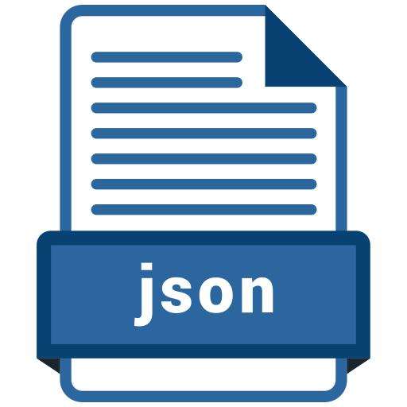
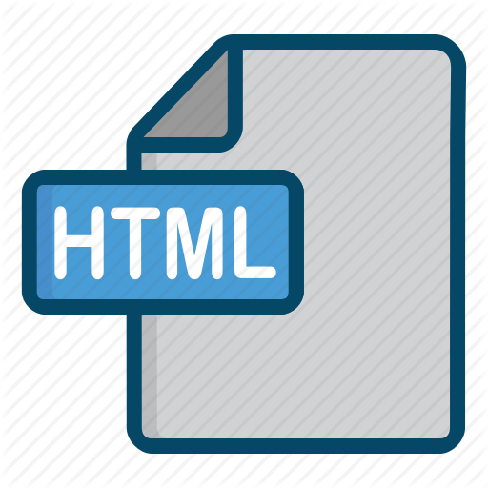

IMPLEMENTATION
The following programming software / languages were used to implement the project:
Python: Python contributes as the main driver code. It implements the crawler using it’s web scrapping tool – BeautifulSoup to extract information.
JSON: JSON format is similar to Strings which allows easy storage of data fetched by the crawler and its additional integration with JavaScript makes it efficient to process the data.
DataTables: The Datatable CDN allows processing of the data stored in JSON files by using in built jQuery libraries and converts the data into an HTML table.
HTML, CSS and JS: The webpages which acts the user interface are implemented using HTML, CSS and JS. Bootstrap was used to modify the look and feel of the webpage.

Slide 12
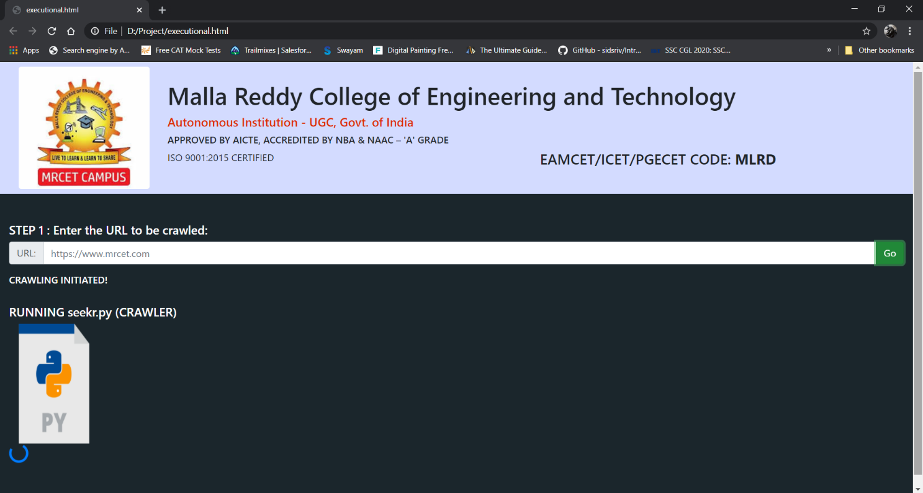
SCREENSHOTS
Homepage

Slide 13
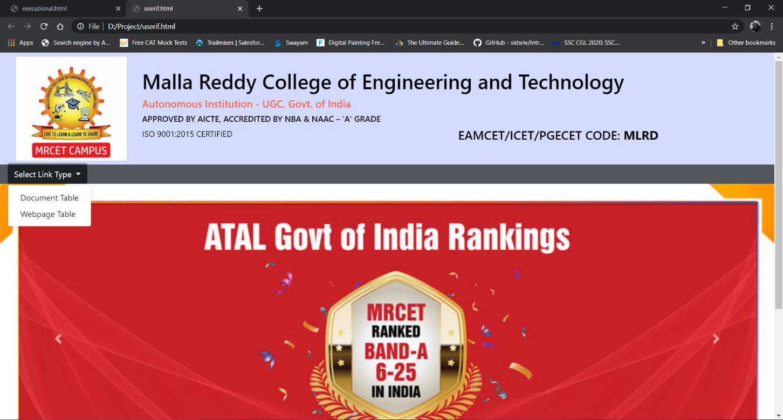
SCREENSHOTS (continued…)
Main User Page

Slide 14
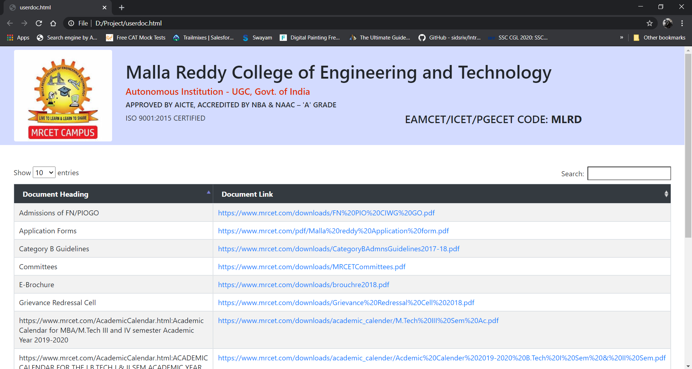
SCREENSHOTS (continued..)
Document Retriever

Slide 15
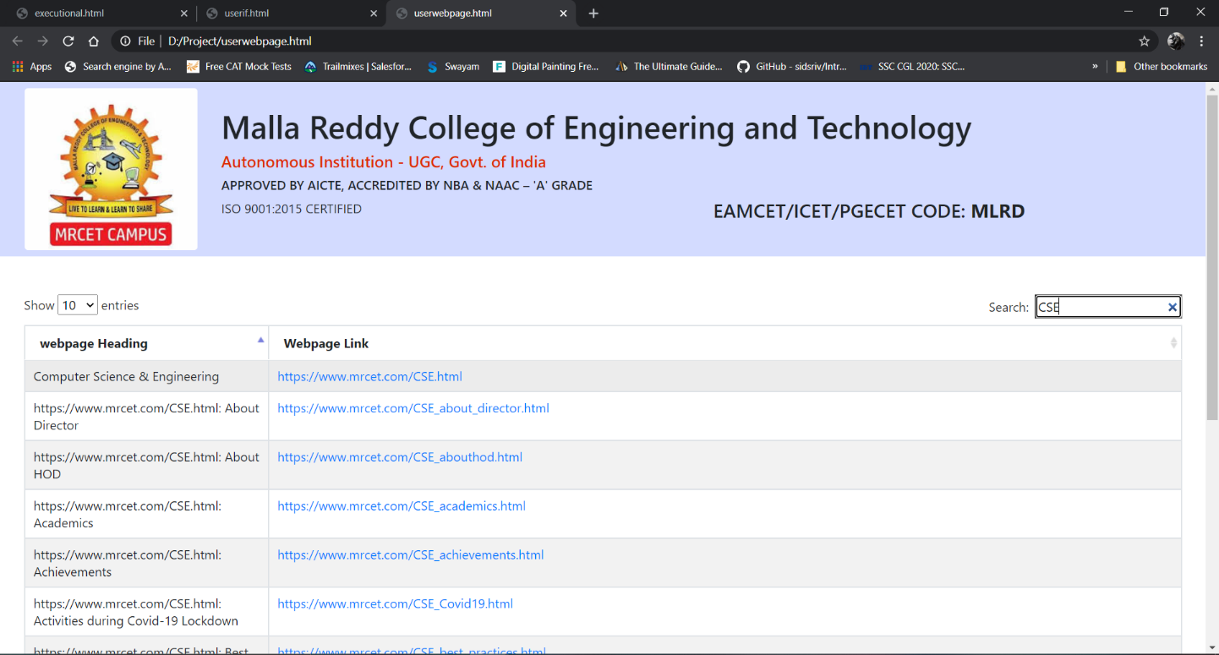
SCREENSHOTS (continued..)
Webpage Retriever

Slide 16
CONCLUSION
Efficient crawling system enables quick and precise retrieval of search results in comparison to the traditional system, which allows the user to save time, effort put into the process.
The data from the webpage is retrieved using the crawler module (driver code), file processing system (JSON files) and displayed with the help of a user interface (webpage).
Future enhancements:
While, the project focuses on precise and accurate retrieval of information, the information fetched is dependent on the performance of the server machine, network download and upload speeds and response time of the destination server, therefore the results fetched may vary with time, device and network used. This can be improved by increasing the accuracy of the retrieval process by maintaining a higher performance device and better network to ensure accurate retrieval of the data items.
The project’s scope of functionality is limited to the college’s website, which can be further generalized, for any user to access the required information.
A dedicated server may be utilized to store all the information fetched, rather than a file system, for a much more integrated, efficient processing of data.

Slide 17
BIBLIOGRAPHY
Books used for reference are:
Programming and Problem Solving with Python | Second Edition (McGraw Hill Publications)
Practical Web Scraping for Data Science: Best Practices and Examples with Python (Book by Bart Baesens and Seppe vanden Broucke, Apress Publishers)
Webpages used for reference:
https://docs.python.org/3/tutorial/index.html
https://docs.python.org/3/library/index.html
https://docs.python.org/3/installing/index.html
https://pypi.org/project/beautifulsoup4/
https://www.json.org/json-en.html
https://www.w3schools.com/html/default.asp
https://datatables.net/manual/
https://www.w3schools.com/bootstrap4/default.asp
https://www.w3schools.com/python/python_json.asp

Slide 18


